Slide 1
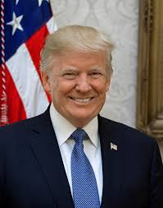
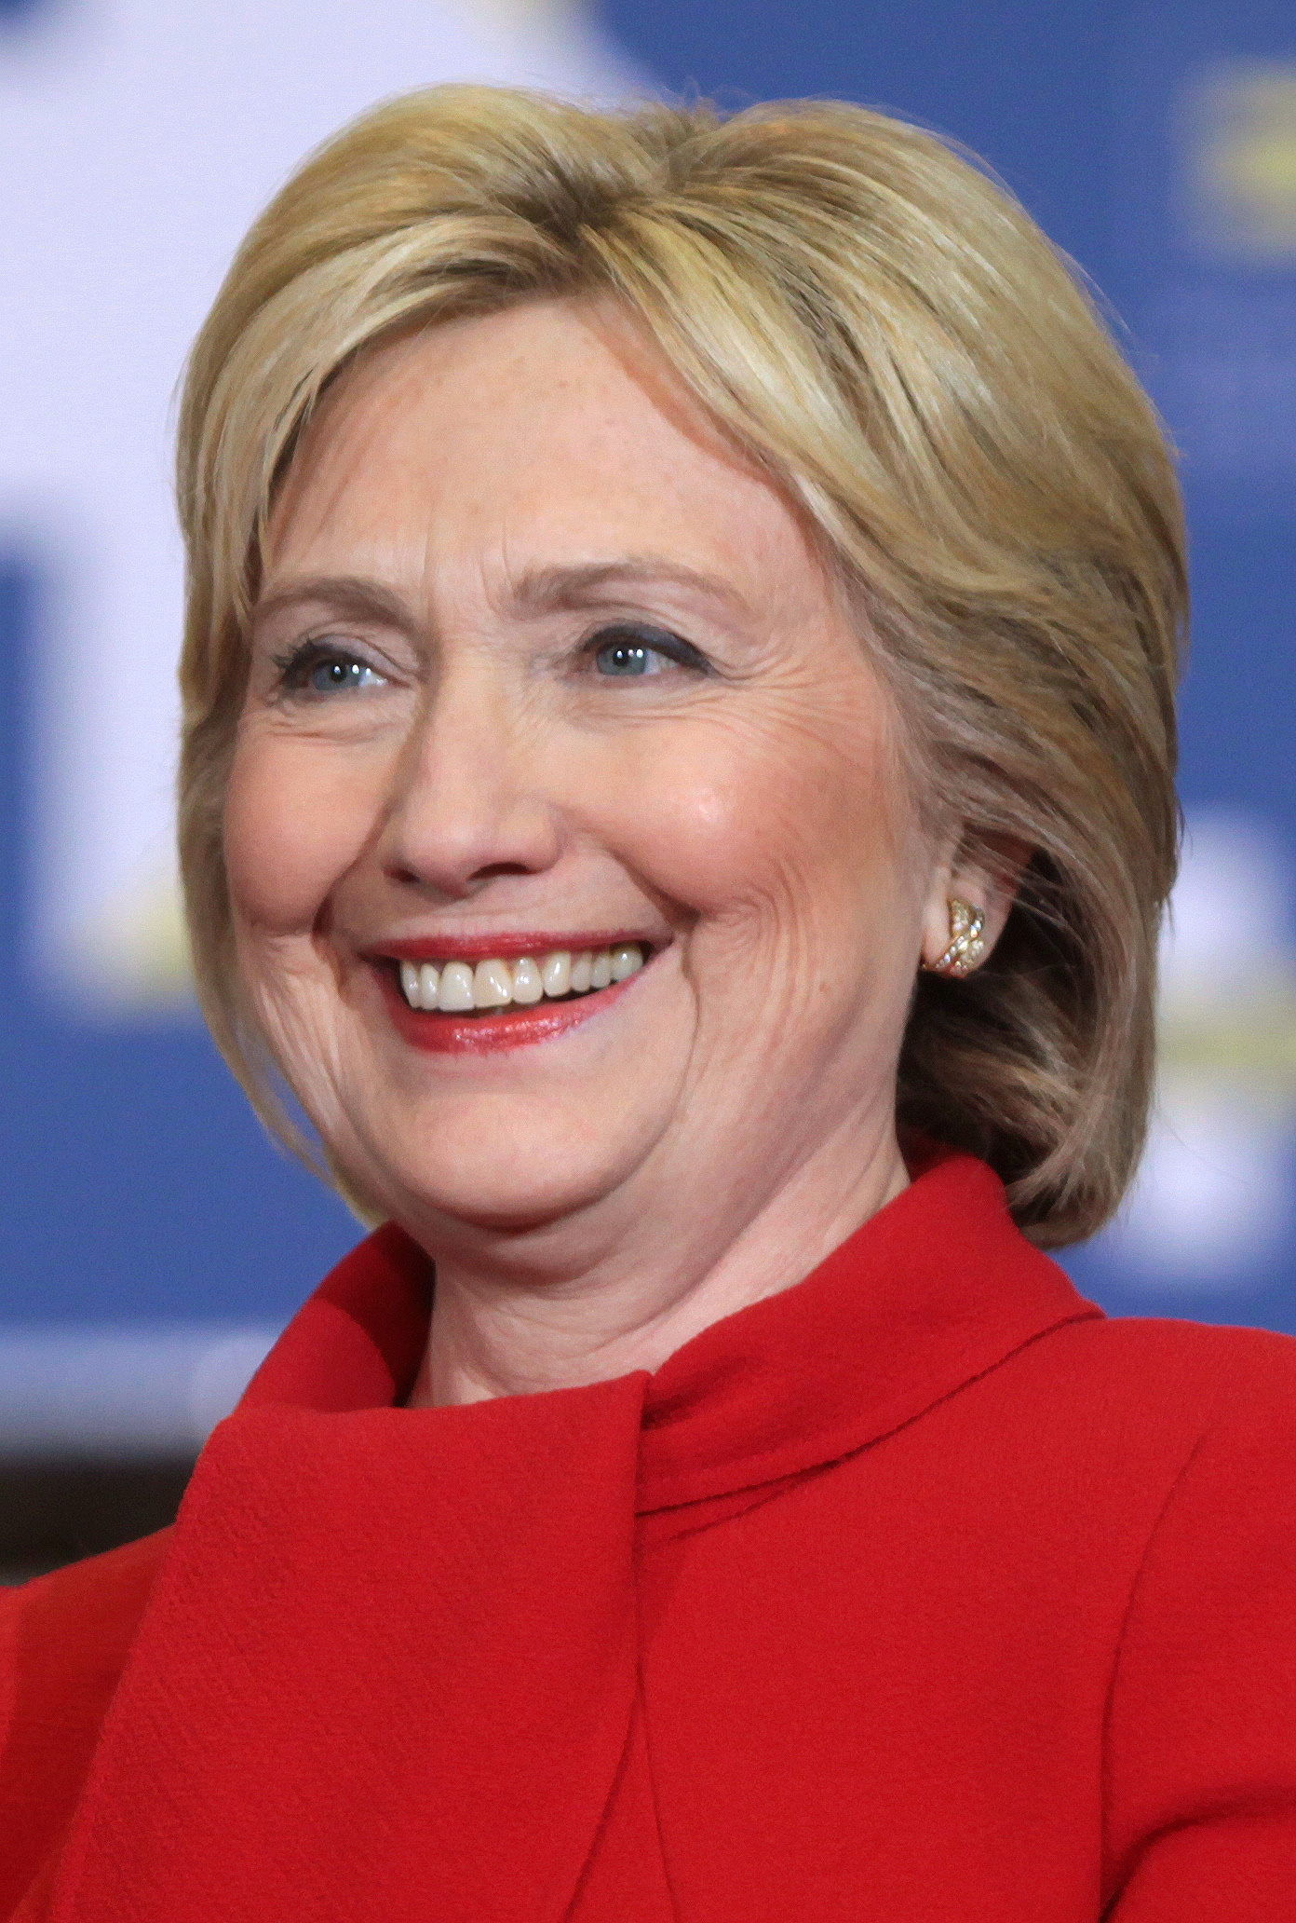

Analysis of Donald Trump and Hillary Clinton’s Tweets
Ye Wang, Corey Crenshaw, Hannah Belsinger,
Alison Price, and Serena Bastian

Slide 2
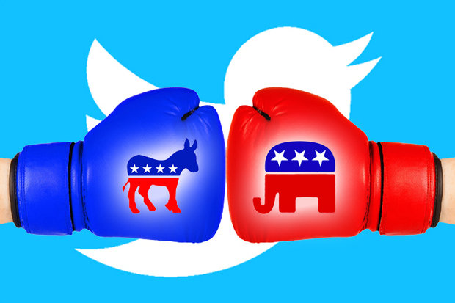
Data Set Overview
Hillary Clinton and Donald Trump Tweets Dataset
Records contain Tweets in which Hillary Clinton and/or Donald Trump created, reproduced, or replied to during the 2016 US presidential election campaigns. After cleaning the data relevant to our analysis, there are 6,444 records and 11 columns.
Why this data set interested our team?
This dataset interested our team because we thought it would be insightful to do text mining on Tweets. We chose Donald Trump and Hillary Clinton’s tweets because we suspect Twitter played a primary role in the 2016 election, indicating that having a social media presence immensely influence the outcome of political campaigns.
Notes:
\

Slide 3
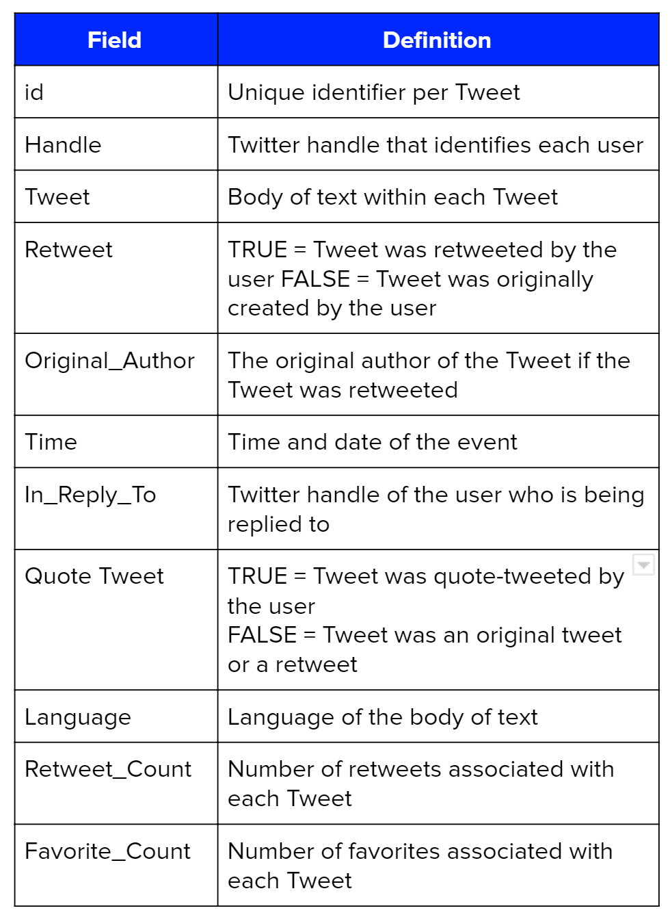
Dataset Overview
Column Distributions and Statistics
Handle - 3,226 Tweets from @HillaryClinton, 3,218 Tweets from @realDonaldTrump
Retweets - 722 total retweets, 5,722 non-retweeted Tweets
Original Authors - There are 279 unique authors from which Trump and Hillary have retweeted Tweets
Time - The dataset analyzes Tweets over a 267 day period, from 01/05/2016 to 09/28/2016
In Reply To - Trump and Hillary replied to 12 unique Twitter accounts
Quote Tweets - Trump and Hillary posted 6,234 total non-quote Tweets and 210 total quote Tweets
Language - Clinton and Trump created 79 and 85 non-English Tweets, respectively.
Notes:
Alison

Slide 4
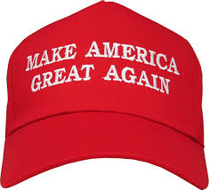
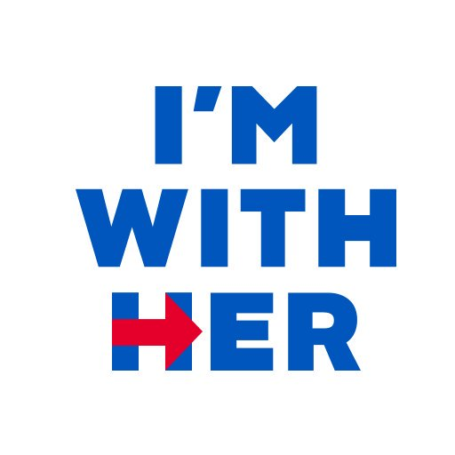
Key Questions
Is Donald Trump or Hillary Clinton more active on Twitter?
What are the most popular topics each candidate talks about?
Based on the candidates’ most frequently used terms, are their Tweets more or less effective when these terms are used?
Do Tweets made by the presidential candidates include more positive or negative words?
Does the use of sentimental words affect the number of likes and retweets on a candidate’s Tweet?

Slide 5
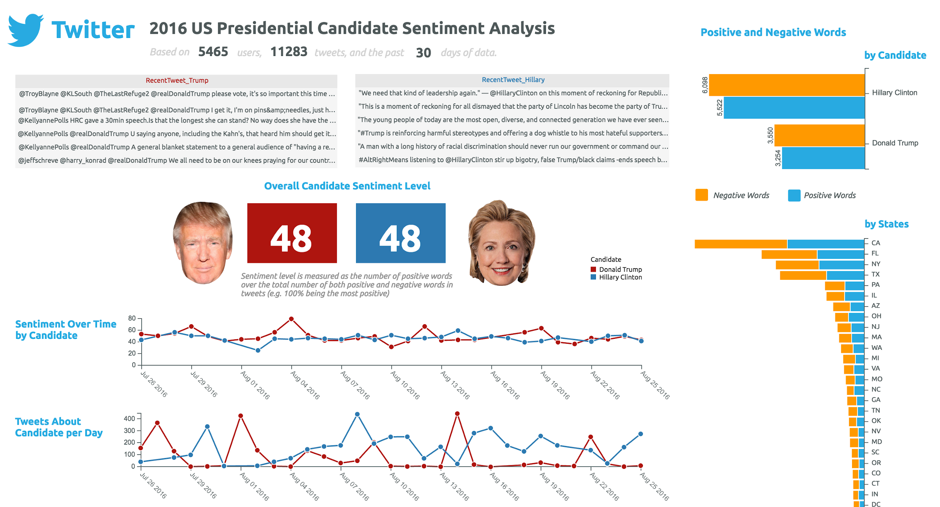
Connection to App
Our App Idea:
A dashboard application showing information on Trump and Clinton’s tweets from the 2016 Presidential Election such as important summary statistics, most popular tweets and most common topics.
A user can access this dashboard if they want to see a general overview and gather basic information about Trump or Clinton’s tweets during the 2016 campaign.
These summary statistics can provide further insight into not only who the target audience is, but also what strategy should be implemented in terms of campaign initiatives, speaking points, and messages directed towards supporters.
We would create relevant campaign advertisements based on the relevant topics candidates tweet about in correlation with what tweets supporters favor the most.
Notes:
\

Slide 6
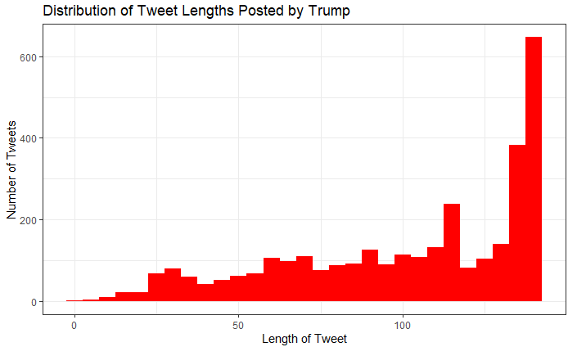
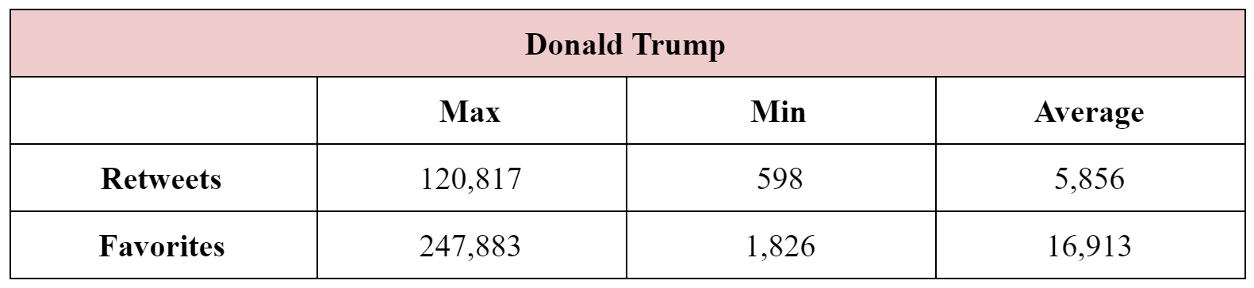
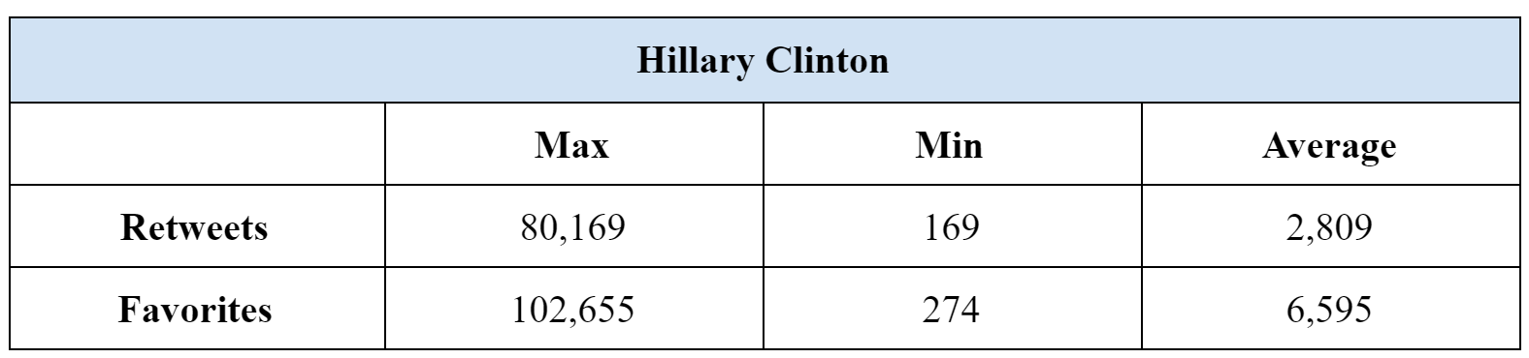
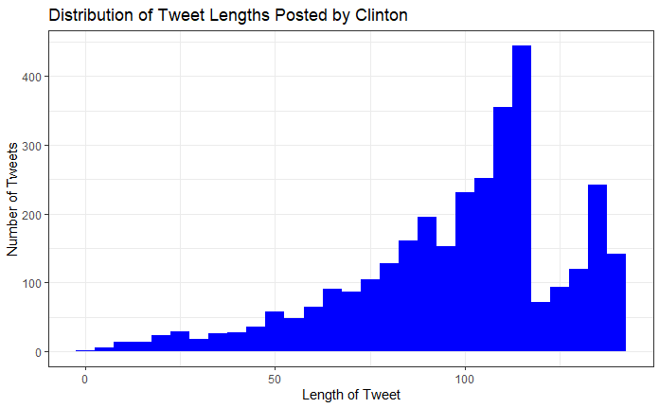
Exploratory Data Analysis
It appears that Trump not only tweeted more frequently,
but the length of his Tweets were much longer than the length
of Hillary’s Tweets. These characteristics could contribute to the
popularity and favorites that his Tweets received allowing us to
better understand how to communicate with supporters.

Slide 7
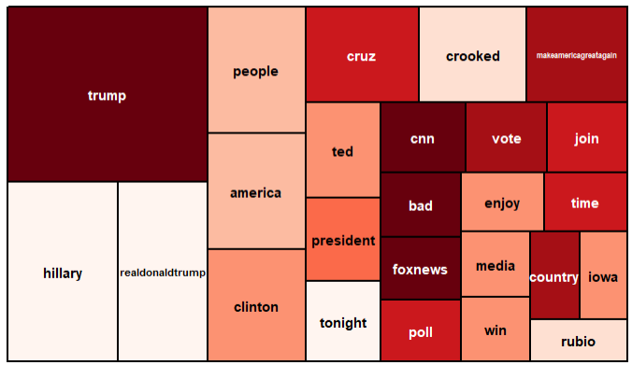
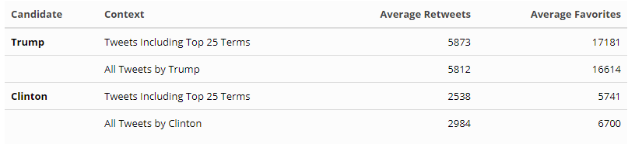
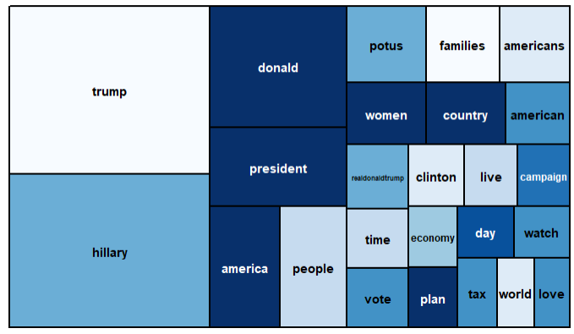
Analysis and Insights
Top 25 Terms Tweeted by Trump
Top 25 Terms Tweeted by Clinton
Both Trump and Clinton have very similar words for the top 5 results, both frequently mentioning each other with Trump and Hillary being the most used words. Other popular words among both candidates include people and america, indicating similarities in communication strategies and rhetoric.
When the top 25 terms used by each candidate are present, Trump’s Tweets appear to perform better, while Clinton’s Tweets appear to perform worse.

Slide 8
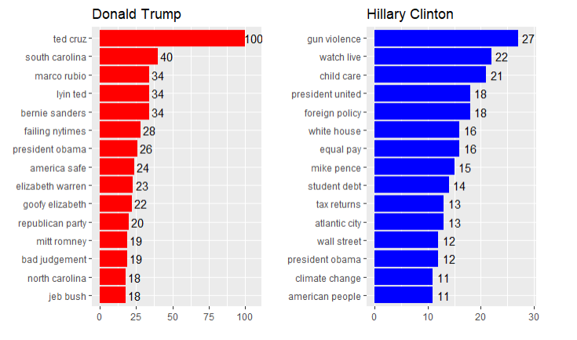
Analysis and Insights
Which topics do each candidate talk about the most?
Hillary Clinton tends to discuss popular campaign topics such as gun violence, student debt, and climate change. Donald Trump’s Tweets are more directed towards other politicians, both Republican and Democratic. Given that Trump had more retweets and favorites overall, mentioning other politicians in his Tweets could have resulted in higher Tweet interactivity.
Notes:
.

Slide 9
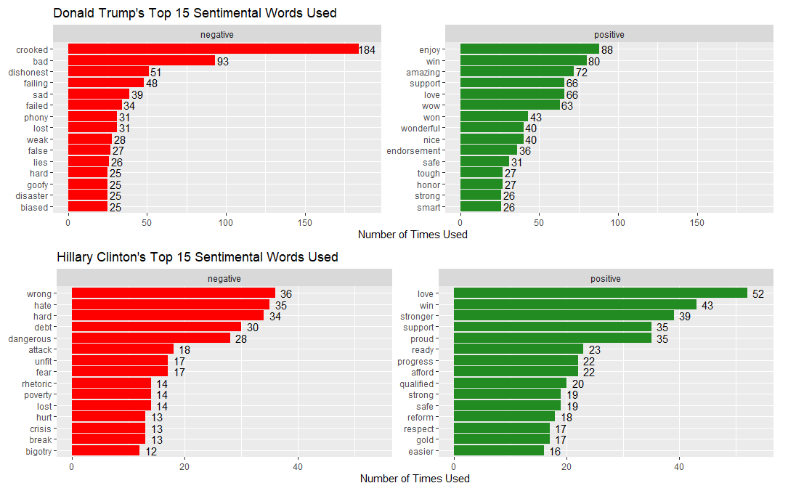
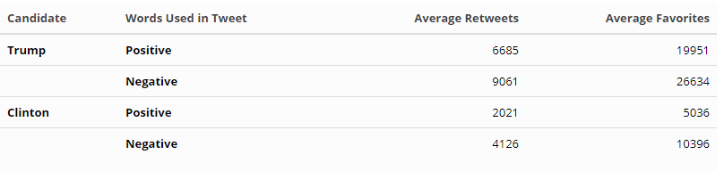
Analysis & Insights
Tweets from which Top 15 positive and negative sentimental words were found:
Trump - 48% negative words
Clinton - 43% negative words
Comparing all of both candidates’ Tweets with positive and negative sentimental words
Both candidates saw significantly better performance in Tweets with negative words than in Tweets with positive words

Slide 10
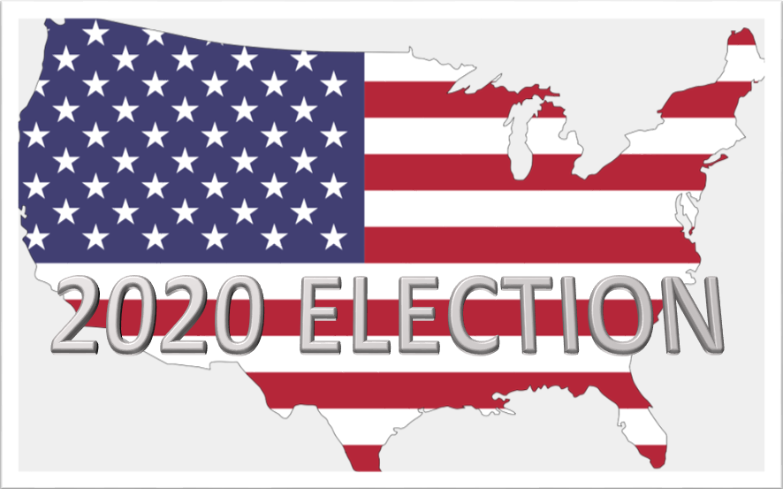
Conclusion
Text analysis of political communication via Twitter indicates likelihood of a positive influence on the outcome of political campaigns (based on increased interactivity, average retweets, and favorites)
There is likely a positive relationship between candidates most active on Twitter and having winning election results
Sentiment Analysis: All conversation is good conversation
In fact negative tweets attract more attention and overkill (Tweeting often) doesn't seem to be an issue
Understanding popular trends like common keywords, tweet length, frequency, and most retweeted topics allows candidates to better speak to their audience and engage based on relevant topics
Great tool for learning and enhancing (not promising) success of future campaign strategy if utilized correctly!

